Slide 1
Semiconductor
P-N Junction
Applied Physics
(Computer Science Department)
Kashish Goindani & Geeta Khatri

Slide 2
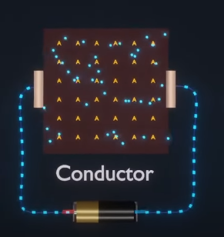
Conductor
Conductors are the materials or substances which allow electricity to flow through them.
They conduct electricity because they allow electrons to flow easily inside them from atom to atom.
Ex: Copper, Brass, Steel, Gold, and Aluminium

Slide 3
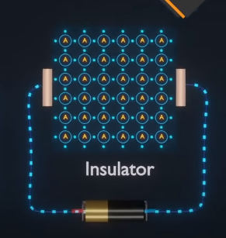
Insulator
Insulator materials that do not allow electricity to pass through them.
Ex : glass, air, wood, plastic and rubber.

Slide 4
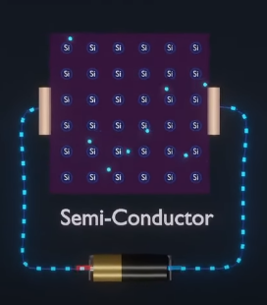
Semiconductor
Semiconductors are materials which have a conductivity between conductors (generally metals) and nonconductors or insulators (such as most ceramics).
Ex : silicon, germanium

Slide 5
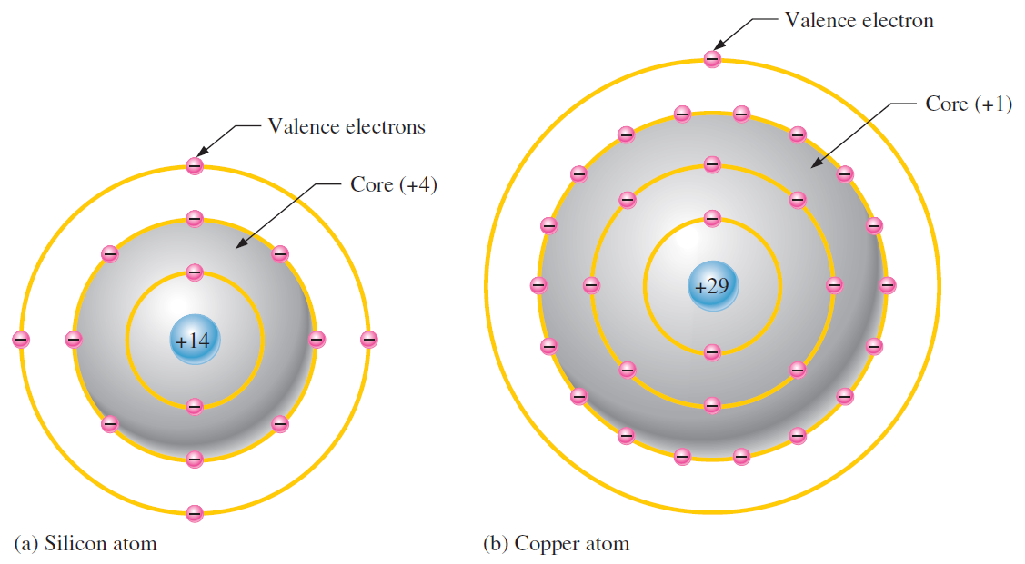
Comparison of a Semiconductor Atom to a Conductor Atom
Silicon is a semiconductor and copper is a conductor.
Bohr diagrams of the silicon atom and the copper atom are shown in Figure.
Notice that the core of the silicon atom has a net charge of +4 (14 protons – 10 electrons) and the core of the copper atom has a net charge of +1 (29 protons – 28 electrons).
Recall that the core includes everything except the valence electrons.
The valence electron in the copper atom “feels” an attractive force of +1 compared to a valence electron in the silicon atom which “feels” an attractive force of +4.
Therefore, there is more force trying to hold a valence electron to the atom in silicon than in copper.
This means that it is easier for valence electrons in copper to acquire enough additional energy to escape from their atoms and become free electrons than it is in silicon

Slide 6
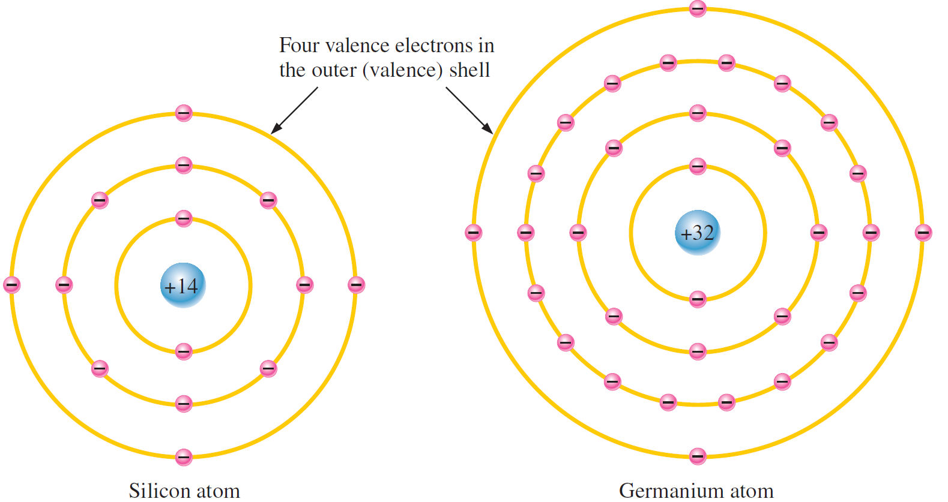
Silicon and Germanium
The atomic structures of silicon and germanium are compared in Figure.
Silicon is used in diodes, transistors, integrated circuits, and other semiconductor devices.
Notice that both silicon and germanium have the characteristic four valence electrons.
The valence electrons in germanium are in the fourth shell while those in silicon are in the third shell, closer to the nucleus.
Germanium require a smaller amount of additional energy to escape from the atom as compare to silicon.
This property makes germanium more unstable at high temperatures and results in excessive reverse current.
This is why silicon is a morewidely used semiconductive material.

Slide 7
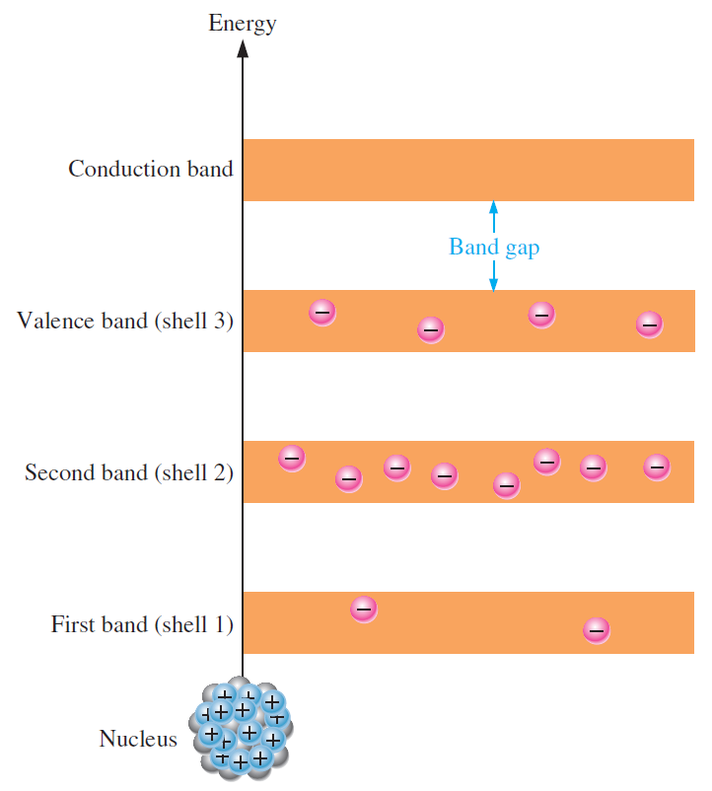
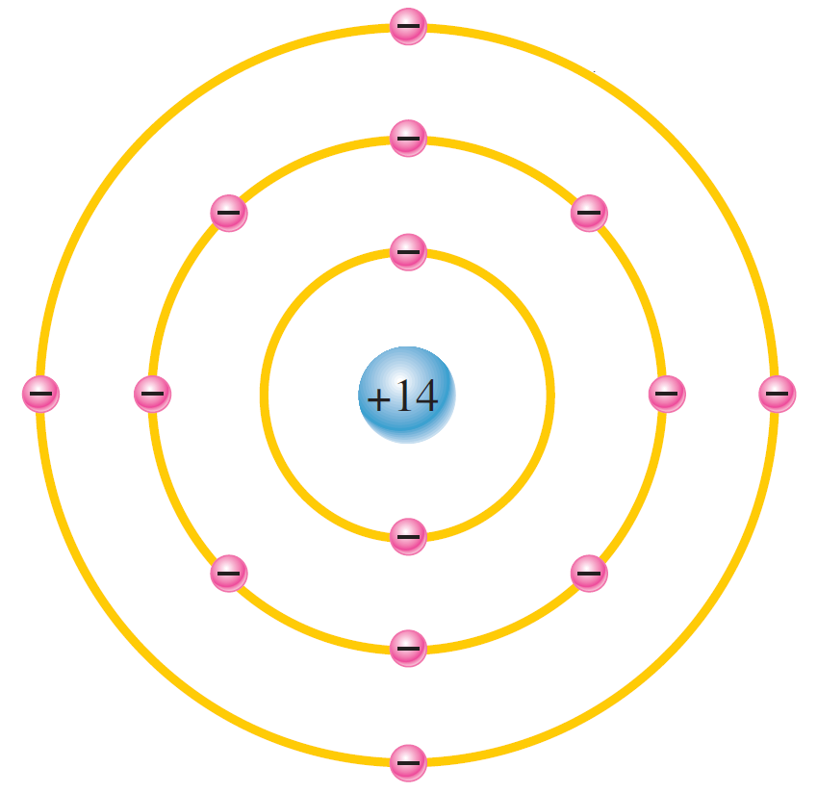
Current in Semiconductors
Figure shows the energy band diagram for the atoms in a pure silicon crystal at its lowest energy level.
There are no electrons shown in the conduction band, a condition that occurs only at a temperature of absolute 0 Kelvin
Conduction Electrons and Holes
An intrinsic (pure) silicon crystal at room temperature has sufficient heat (thermal) energy for some valence electrons to jump the gap from the valence band into the conduction band, becoming free electrons.
Free electrons are also called conduction electrons.

Slide 8
Comparison
Semiconductor Atom
Conductor Atom

Slide 9
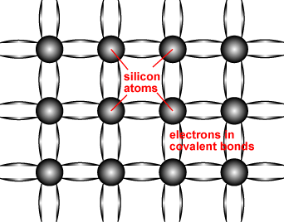
Structure of Semiconductor
Semiconductors, such as Silicon are made up of individual atoms bonded together in a regular, periodic structure.
Each atom forms 4 covalent bonds with the 4 surrounding atoms to form an arrangement whereby each atom is surrounded by 8 electrons.

Slide 10
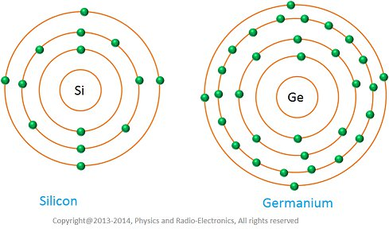
Silicon and Germanium

Slide 11
Characteristics of Semiconductor
A semiconductor is a material that has a very low electrical resistance.
It is very pure chemically and has only one defining characteristic conduction.
When exposed to an electric field, electrons in this material will move at a very high speed. The same applies to holes.

Slide 12
Types of Semiconductor
Intrinsic
. Extrinsic
. N-type
. P-type

Slide 13
Extrinsic Semiconductors
Intrinsic Semiconductor
The number of excited electrons is equal to the number of holes (n = p).
pure semiconductor, undoped semiconductor , or i-type semiconductor.
A semiconductor without any significant amount of impurity.
Extrinsic semiconductors are semiconductors that are doped with specific impurities.
The impurity modifies the electrical properties of the semiconductor and makes it more suitable for electronic devices such as diodes and transistors.
They exhibit poor electrical conductivity.

Slide 14
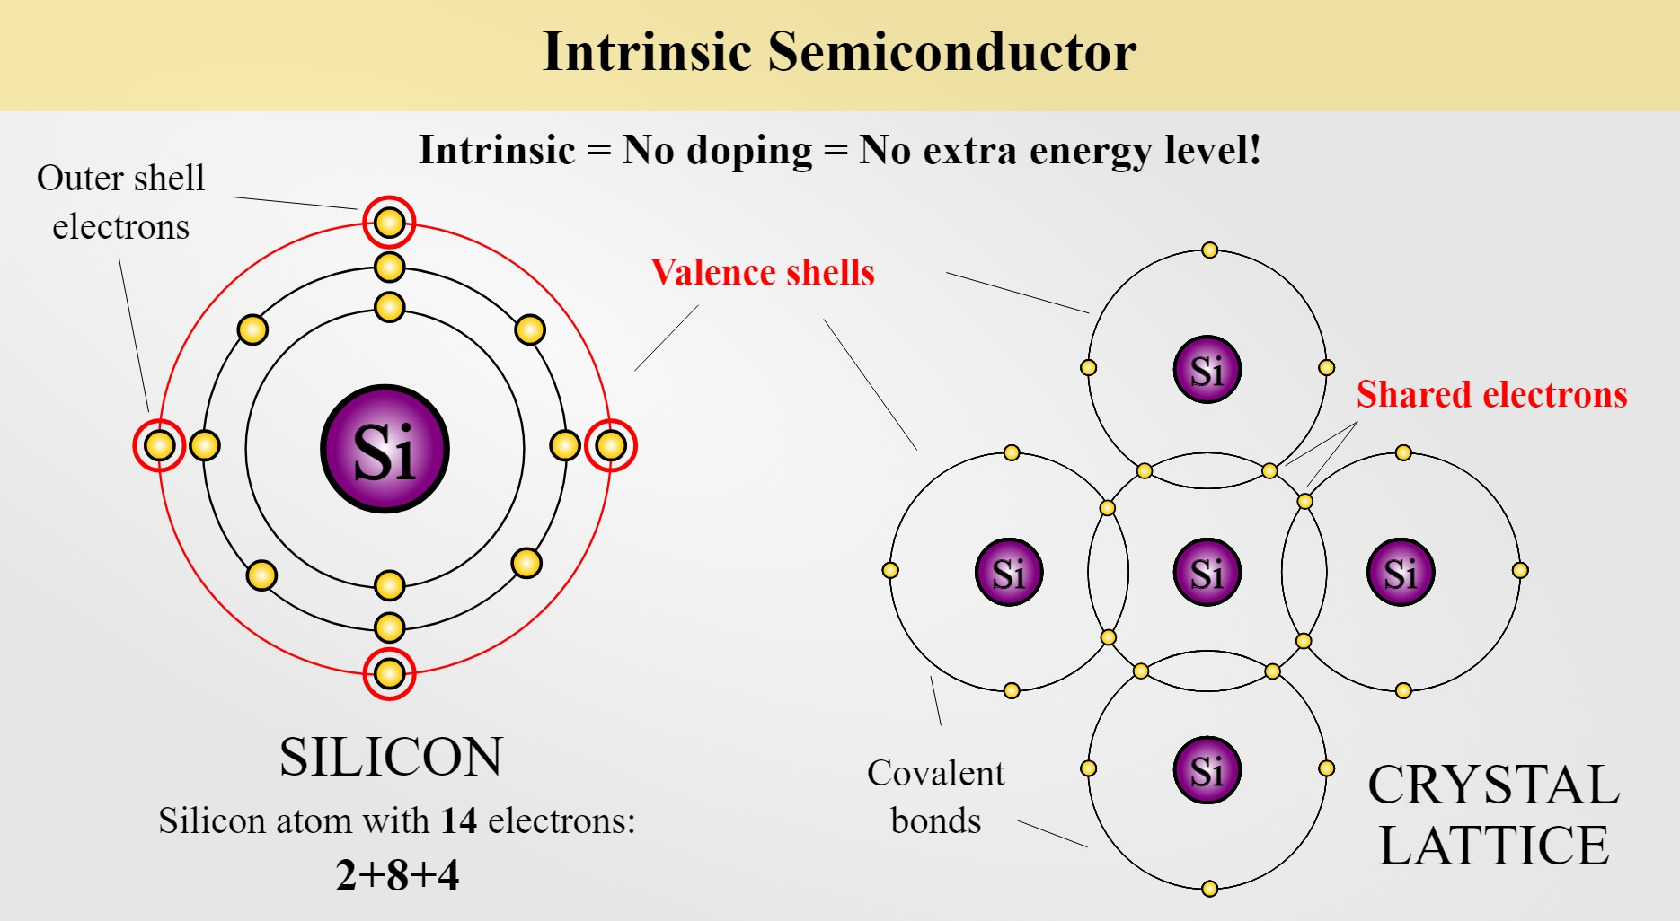

Slide 15
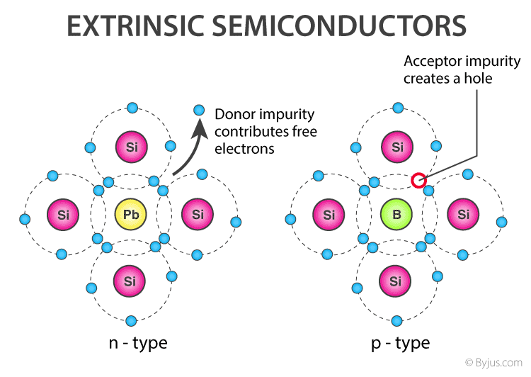

Slide 16
P-type Semiconductor
P-type semiconductor is formed due to the dopping of III group elements
i.e. Boron, Aluminium, Thallium
These are also known as Trivalent semi conductors
P-type semiconductors is positive type semiconductor it means it deficiency of 1 electron is required
In P-type semiconductor majority charge carries are holes and minority charge carries are electrons.
A hole indicates a missing electron. In this no. of holes is more than the no. of electrons.

Slide 17
N-type Semiconductor
N-type semi conductor is formed due to dopping of Nitrogen,
Phosphorus, Arsenic, Antimony, Bismuth
These are also known pentavalent semiconductor
N-type semiconductor is negative type semi-conductor it means excess of 1 electron is required
In N-type semiconductor majority charge carries are electrons and minority charge carries are hole.
In N-type semiconductor the no. of holes is less than the no. of free electron

Slide 18
P-N Junction Diode:
Is is a semiconductor with n and p type materials that are chemically combined, forms a junction that allows conduction in one direction only.

Slide 19
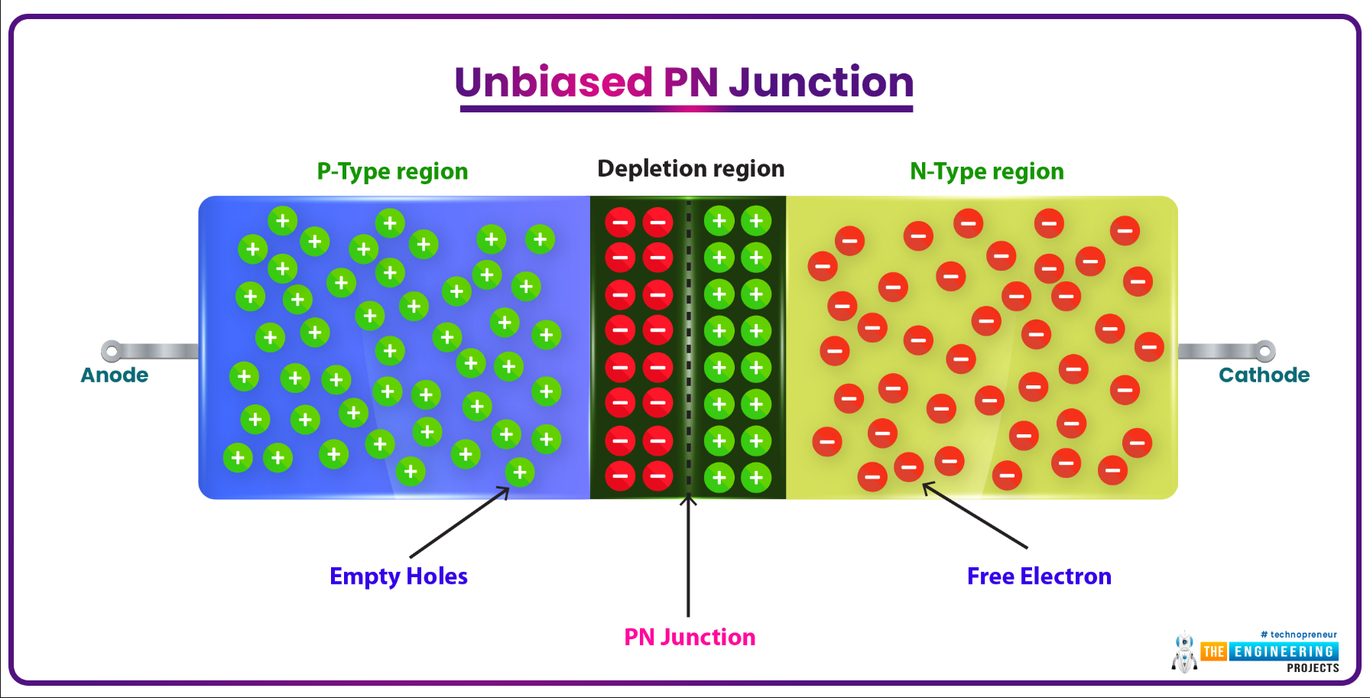

Slide 20
Characteristics of a Diode:
Forward biased diode
Reverse biased diode
Zero biased diode

Slide 21
Forward Biased Diode:
When the diode is forward-biased and the current is flowing, there is a minor voltage drop across it. The potential energy across the p-type material is positive, while the potential energy across the n-type material is negative.

Slide 22
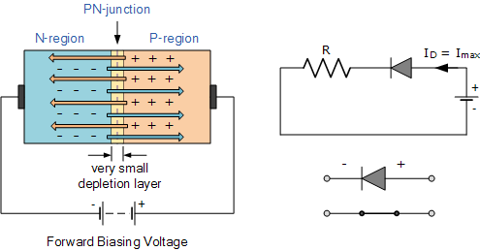
Forward Biased Diode

Slide 23
Reverse Biased Diode:
A diode is said to be reverse-biased when the battery voltage is totally depleted (battery has been completely discharged and current does not flow). The potential energy across the p-type material is negative, while the potential energy across the n-type material is positive.

Slide 24
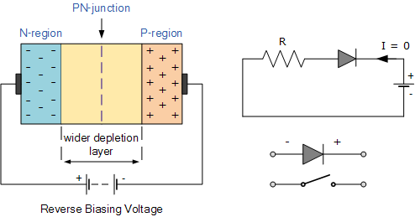

Slide 25
Thankyou…

